Slide 1
SS G515 - Data Warehousing
Dr. Yashvardhan Sharma
Assistant Professor, CS & IS Dept.
BITS-Pilani

Slide 2
Design Requirements
Design of the DW must directly reflect the way the managers look at the business
Should capture the measurements of importance along with parameters by which these parameters are viewed
It must facilitate data analysis, i.e., answering business questions

Slide 3
ER Modeling
A logical design technique that seeks to eliminate data redundancy
Illuminates the microscopic relationships among data elements
Perfect for OLTP systems
Responsible for success of transaction processing in Relational Databases

Slide 4
Problems with ER Model
ER models are NOT suitable for DW?
End user cannot understand or remember an ER Model
Many DWs have failed because of overly complex ER designs
Not optimized for complex, ad-hoc queries
Data retrieval becomes difficult due to normalization
Browsing becomes difficult

Slide 5
ER vs Dimensional Modeling
ER models are constituted to
Remove redundant data (normalization)
Facilitate retrieval of individual records having certain critical identifiers
Thereby optimizing OLTP performance
Dimensional model supports the reporting and analytical needs of a data warehouse system.

Slide 6
Dimensional Modeling: Salient Features
Represents data in a standard framework
Framework is easily understandable by end users
Contains same information as ER model
Packages data in symmetric format
Resilient to change
Facilitates data retrieval/analysis

Slide 7
Dimensional Modeling: Vocabulary
Measures or facts
Facts are “numeric” & “additive”
For example; Sale Amount, Sale Units
Factors or dimensions
Star Schemas
Snowflake & Starflake Schemas
Sales Amt = f (
Product,
Location,
Time)
Fact
Dimensions

Slide 8
Star Schema
FK FK
FK FK
Product
Dimension
Location
Dimension
Sales Fact
Table
Time
Dimension
Promotion
Dimension

Slide 9
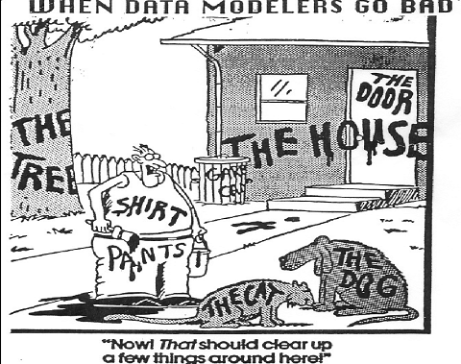
What Is Dimensional Modeling?

Slide 10
What is Dimensional Modeling (DM)?
DM is a logical design technique that seeks to present the data in a standard, intuitive framework that allows for high-performance access.
Can be implemented using a relational or a multidimensional DBMS
Every dimensional model is composed of one table with a multipart key, called the fact table, and a set of smaller tables called dimension tables.
Each dimension table has a single-part primary key that corresponds exactly to one of the components of the multipart key in the fact table.
This characteristic "star-like" structure is often called a star join.

Slide 11
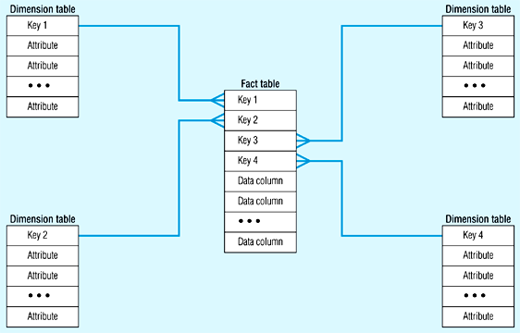
Star Schema (in RDBMS)

Slide 12
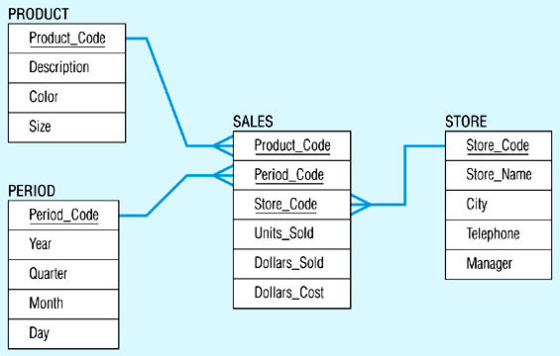
Star Schema Example

Slide 13
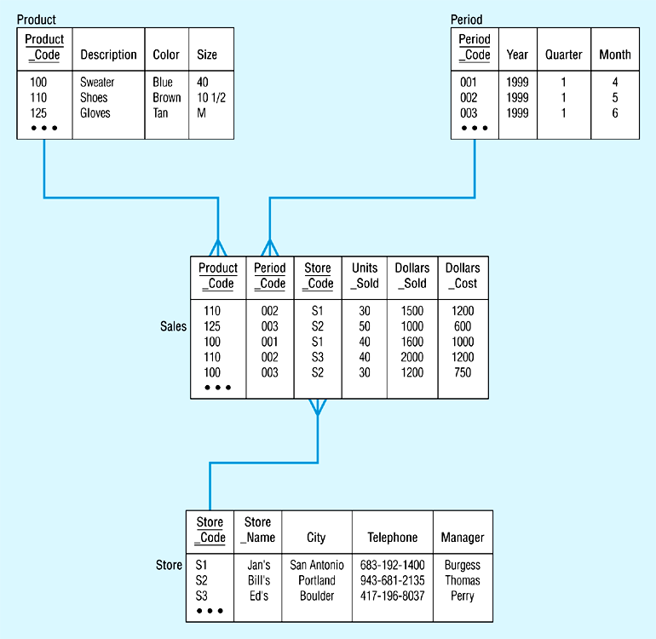
Star Schema with Sample Data

Slide 14
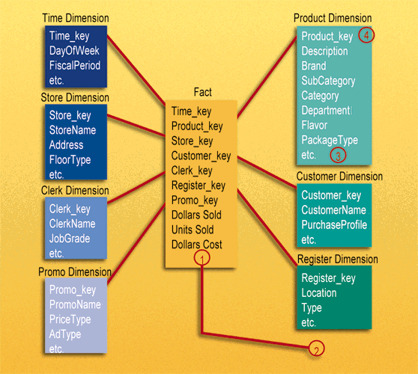
Dimensional Model Example

Slide 15
Star Schema
Singe data (fact) table surrounded by multiple descriptive (dimension) tables
Fact
Dim
Dim
Dim
Dim
Dim

Slide 16
Dimensional Model: Fact Tables
A fact table contains information about things that an organization wants to measure.
A fact table’s key is made up from the keys of two or more parents or dimension tables.
A fact always ‘resolves’ a many-to-many relationship between the parent, or dimension tables.
The most useful fact tables also contain one or more numerical measures, or facts, that occur for the combination of keys that define each record.
Example: the facts are Dollars Sold, Units Sold, and Dollars Cost.

Slide 17
Dimensional model: Fact Tables
The most useful facts in a fact table are numeric and additive.
Additivity is crucial because data warehouse applications almost never retrieve a single fact table record; rather, they fetch back hundreds, thousands, or even millions of these records at a time, and often the most useful thing to do with so many records is to add them up.

Slide 18
Fact Tables
Contains numerical measurements of the business
Each measurement is taken at the intersection of all dimensions
Intersection is the composite key
Represents Many-to-many relationships between dimensions
Examples of facts
Sale_amt, Units_sold, Cost, Customer_count

Slide 19
Dimensional Model: Dimension Tables
Dimension tables contain information about how an organization wants to analyze facts:
“Show me sales revenue (fact) for last week (time) for blue cups (product) in the western region (geography)
Dimension tables most often contain descriptive textual information ‘Blue cups’, ‘Western Region’
Dimension attributes are used as the source of most of the interesting ‘constraints’ in data warehouse queries., and they are virtually always the source of the row headers in the SQL answer set.

Slide 20
Dimension Tables
Contains attributes for dimensions
50 to 100 attributes common
Best attributes are textual and descriptive
DW is only as good as the dimension attributes
Contains hierarchal information albeit redundantly
Entry points into the fact table

Slide 21
Terminology
Dimensions
The time independent, textual and descriptive attributes by which users describe objects.
Combining all the attributes including hierarchies, rollups and sub-references into a single dimension is denormalization.
Often the “by” word in a query or report
Not time dependent
Facts
Business Measurements
Most Facts are Numeric
Additive, Semi-Additive, Non-Additive
Built from the lowest level of detail (grain)
Very Efficient
Time dependent

Slide 22
Benefits
Performance (Integer relationships, natural partitioning, Single joins benefit SQL optimizer)
Source system independence and multiple integration
Supports Change management
Usability/Simplicity (easy to read, interpret, join, calculate)
Presentation (Consistency, Taxonomy, Labeling)
Reuse (Conformed dimensions reduce redundancy, Role-plays)

